Slide 1
Co-regulation of NER repair factor expression
Tim Heinemann
Third TAC meeting
17.11.2014

Slide 2
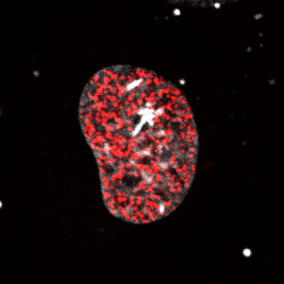
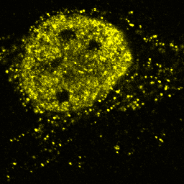
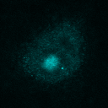
Properties of chromatin-associated processes
DNA replication
RNA transcription
Initiation
Termination
Process
DNA
RNA
DNA repair etc.
Protein

Slide 3
Properties of chromatin-associated processes
Multi-protein
Dynamic Exchange
Specific
I
II
I
II
I
II
?
III
IV
III
IV
III
IV
How do systems properties (fidelity, speed, timing,…) arise from the interplay of many components?
Which components control these properties and define their nature?
Notes:
Hypothesis: systems properties such as fidelity and speed arise from component and substrate inter

Slide 4
Nucleotide Excision Repair (NER) as a paradigm for chromatin-associated processes
Exemplary reaction process comparable to other chromatin associated pathways
Multiple-protein driven: initiation, process execution with high fidelity, termination
Simple induction of DNA repair
UV-light introduces DNA lesions recognized by NER
Components identified
Factors and their functions during NER largely known
System non-essential for viability
Core proteins can be (entirely!) replaced by tagged counterparts
Kinetic information available!
Interaction of proteins with chromatin well researched

Slide 5
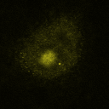
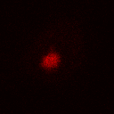

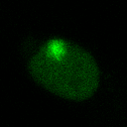
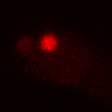
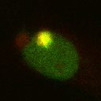
Direct readout for repaired DNA
HeLa
HeLa
XPC
EdU
Merge
5 µm
XP-C XPC-GFP
XPC-GFP
EdU
Merge

Slide 6

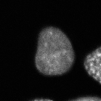
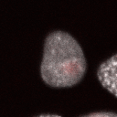
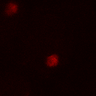
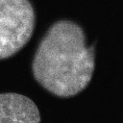
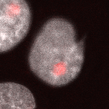
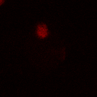
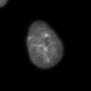
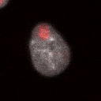
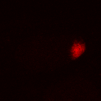
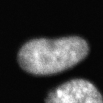
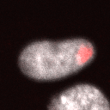
Slow repair with large cell-to-cell variability
30 min post-UV
(repaired DNA)
(Damage)
EdU
DAPI
Merge
5 µm
60 min post-UV
EdU
DAPI
Merge
120 min post-UV
τ ≈ 1.2 h
EdU
DAPI
Merge
180 min post-UV
EdU
DAPI
Merge

Slide 7
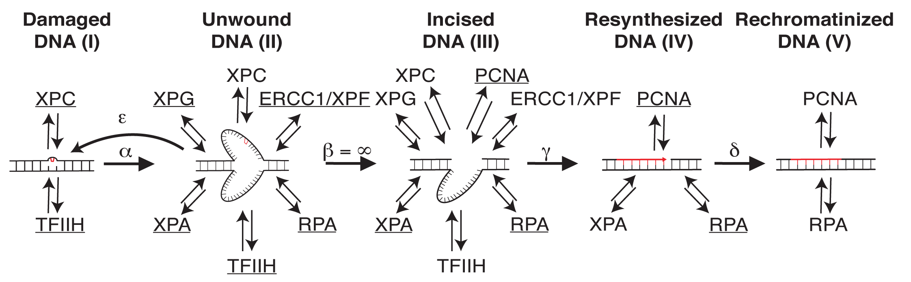
Kinetic modelling of NER
Luijsterburg, M. & Bornstaedt, G. et al. (2010) J. Cell Biol.
Notes:
Fit looks good – parameters are identifiable

Slide 8
Experimental validation of low XPC control over repair kinetic
r = 0.29 (0.16,0.41); p < 0.001
m = 0.46
r = 0.18 (0.03,0.31); p < 0.001
m = 0.31
Notes:
But then – what does control the rate of repair…?
We asked – Can we simulate a random cell that matched the measured data?

Slide 9
Simultaneous measurement of two repair proteins allows cross-correlation analysis
DAPI
dXPC
iXPC
EdU
 | XPC | XPB | XPA | XPF | RPA
XPC | x | x | x | x | x
XPB |  | - | - | x | -
XPA |  |  | - | x | x
XPF |  |  |  | - | -
RPA |  |  |  |  | -
In collaboration with Simon Eck (AG Rohr)

Slide 10
Measurement error smaller than natural variability
Natural variability
Measurement error

Slide 11
NER factors are strongly positively correlated

Slide 12
Cross-correlation is repair independent

Slide 13
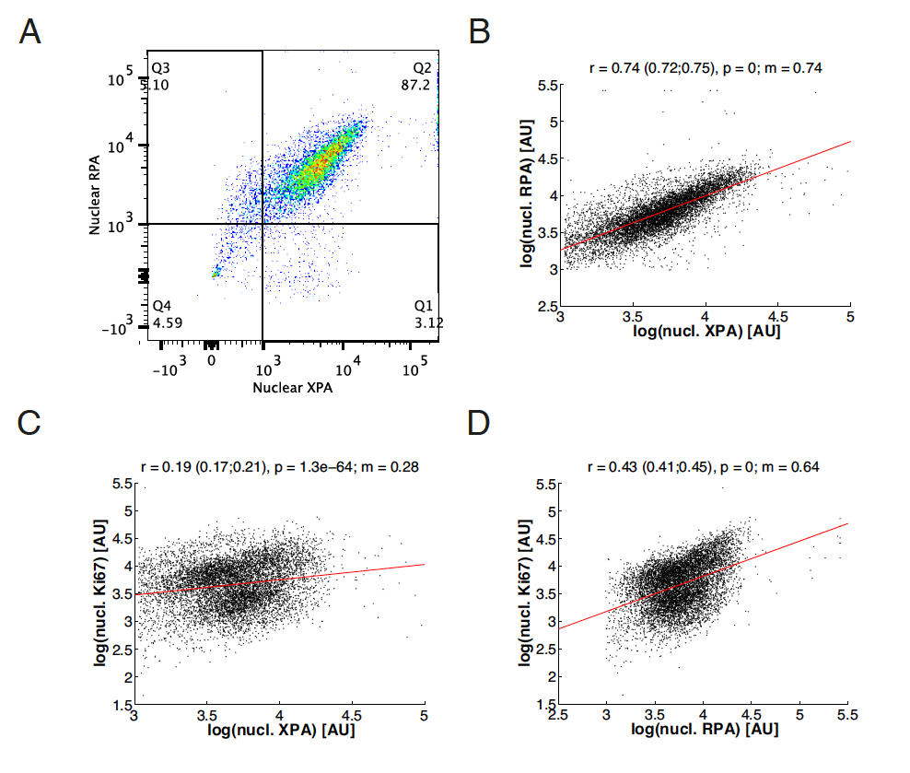
Reduced cross-correlation between NER factors and Ki67
In collaboration with Martin Teichert (AG Augustin)

Slide 14
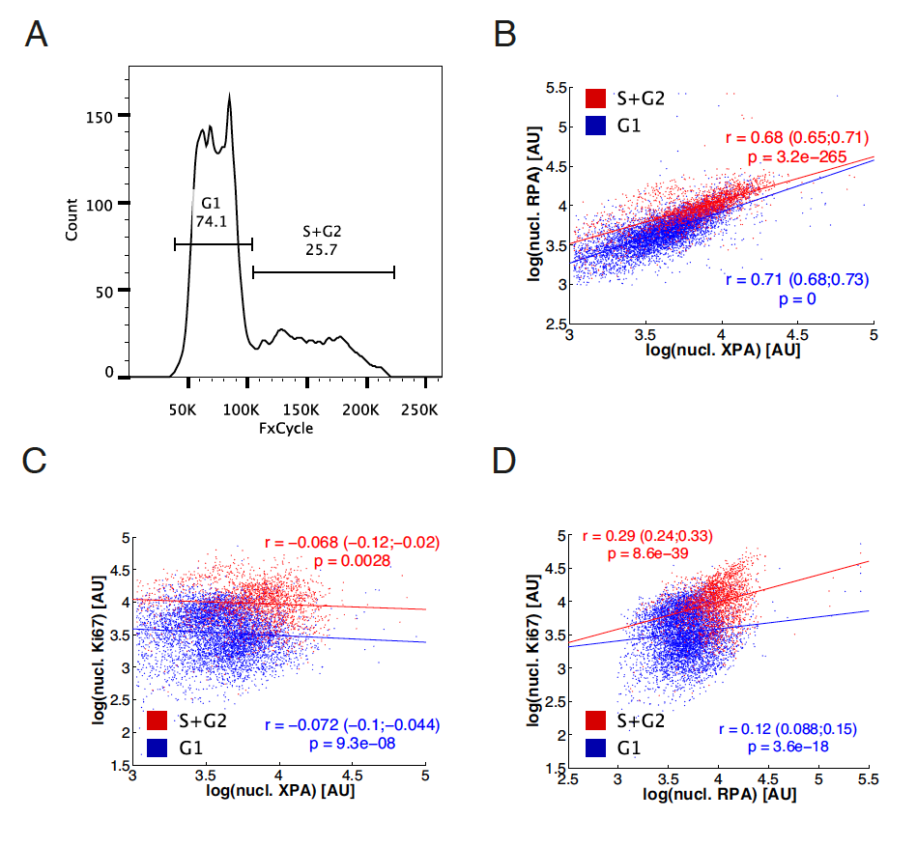
Positive correlation between cell cycle and NER factor expression

Slide 15
Conclusions

